Slide 1
FINAL PROJECT Image recognition- Flowers dataset
Ahmed Lotfy
Brock Kanjicai
Shanker Nair

Slide 2
OUTLINE
App demo
Machine learning models applied
App.py and config
Index.html and basic framework
Heroku deployment
Learnings and conclusions

Slide 3
Data set- Description
5 classes of flowers
Daisy
Dandelions
Roses
Sunflowers
Tulips
800 images in each class.
~ 4000 images in the dataset
102 classes of flowers
40 to 250 images in each class
Unable to find dataset split into classes

Slide 4
Machine Learning Models
Data Split:
Train data: 80%
Validation data: 10%
Test data: 10%
Performance optimization:
Cache
prefetch
Parametric hyper tuning:
Epochs
Batch size
Sequential Model
Transfer Learning
Model 1: Untrained
- 2 Dense layers
Relu activation function
----------------
Normalization
Model 2:
3 Convolution blocks
Relu activation function
Adam optimizer
Model 3: Trained
Pretrained on the ImageNet DB
Fine tune the model

Slide 5
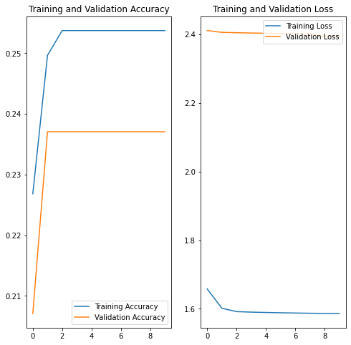
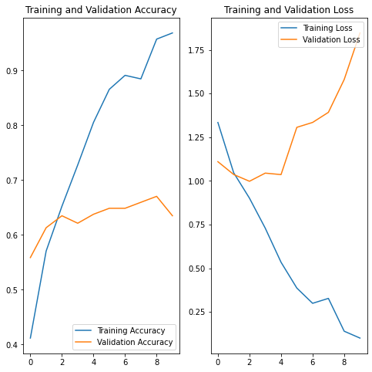
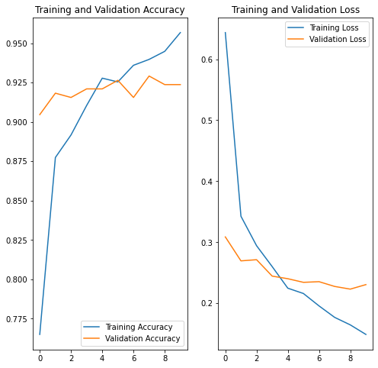
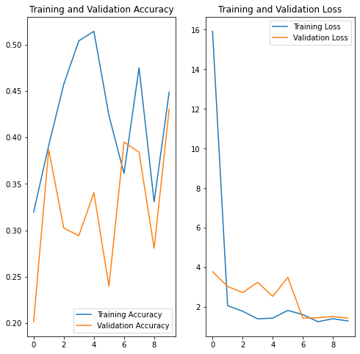
Machine Learning Models
Model 1: Untrained
Model 2: Untrained (Minor Hypertuning)
Model 3: Untrained (Fine tuning)

Slide 6
Model performance

Slide 7
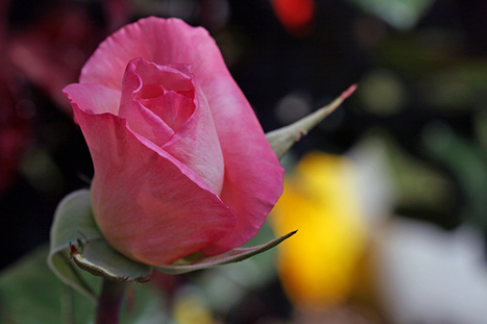
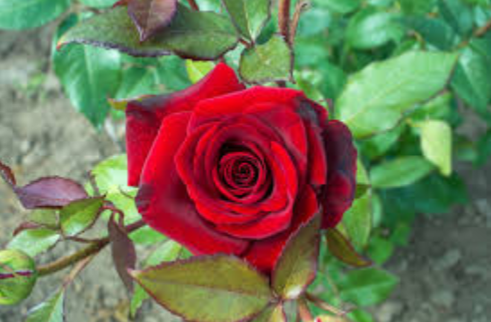

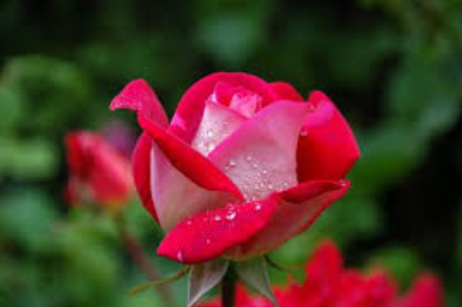

ROSES
Random image from the dataset
Images from the internet

Slide 8
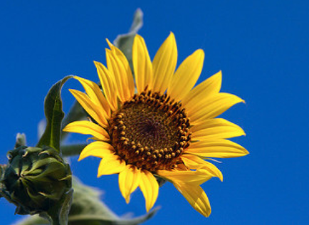
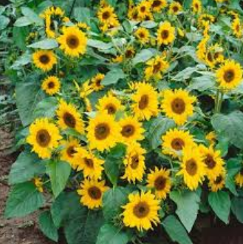
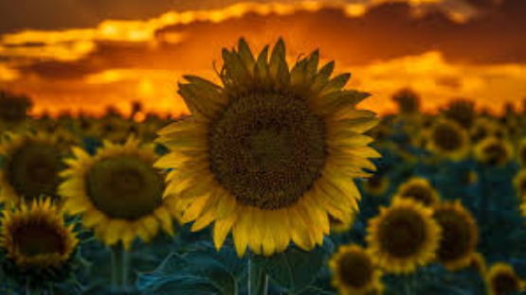
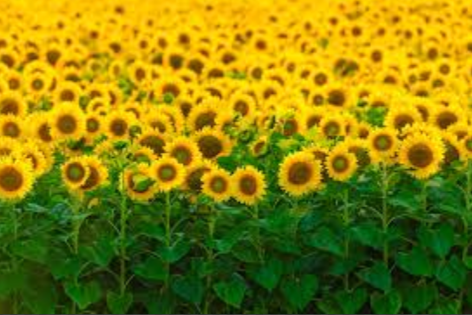
SUNFLOWER
Random image from the dataset
Images from the internet

Slide 9
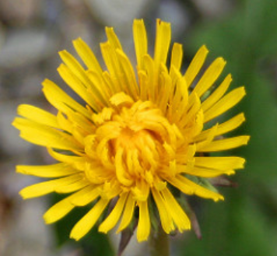
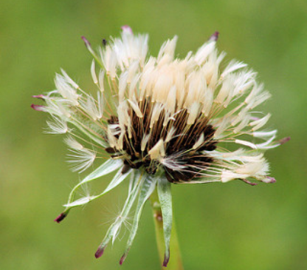
DANDELION
✗
✓

Slide 10
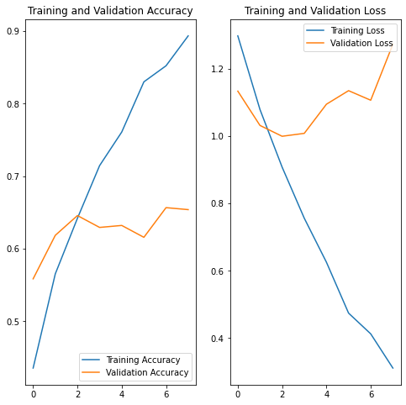
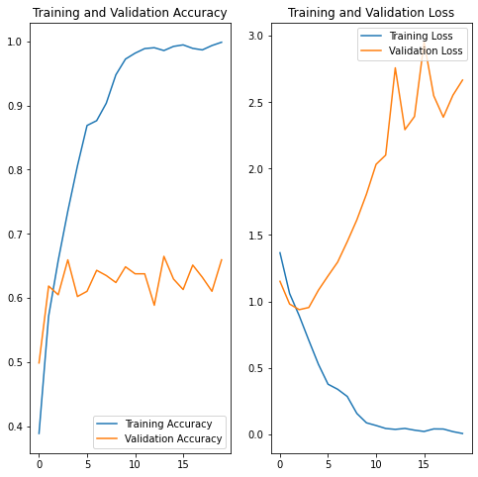
Hyper tuning Parameter: Epoch
Epochs = 8
Epochs = 10
Epochs = 16

Slide 11
Hyper tuning Parameter: Batch Size
Learning Rate
Batch Size
Momentum
Weight Decay
https://medium.com/@aiii/how-to-tune-hyper-parameters-in-deep-learning-a0fa4bc1d782
https://towardsdatascience.com/guide-to-choosing-hyperparameters-for-your-neural-networks-38244e87dafe

Slide 12
SUMMARY
A good understanding of the basics of ML will help tweak several online sources to the use case
Error in predicting certain flower classes was mitigated with the final trained model which was further refined with the users dataset. Option #, although with a validation accuracy of only 65% is predicting random internet images as testing with the main model.
Improvements that can be made:
Drop feature is available instead of browse and will be a good feature to try
Run more images on model #2 and try if it will break and further improve model #2 with hyperas and also manual tuning to understand the cause and effect.

